Slide 1
Ohio EPA Stormwater
Program Manager
Jason Fyffe
614-728-1793
District Stormwater Coordinator(s)
SW Technical Assistance
Statewide SW Coordinator
SW Permitting
Justin Reinhart
614-705-1149
Supervisor
Wesley Sluga
614-644-2141
(NWDO)
Lynette Hablitzel
419-373-3009
What We Do: Complaints, Site Inspections, MS4 Audits
Technical Specialist
VACANT
Michael Joseph
614-752-0782
construction/industrial
What We Do: Construction permit: BMP design, calculations, coverage requirements, SWP3 reviews , technical education, Rainwater Manual
Anthony Robinson
514-728-3392
ms4/industrial
What We Do: What we do: construction, industrial, and municipal coverage submittals, processing, renewals, transfers, and terminations. Industrial sampling and no exposure certification. MS4 annual reports. STREAMS NOI and NOT forms.
Primary Contacts
email address: first.last@epa.ohio.gov

Slide 2
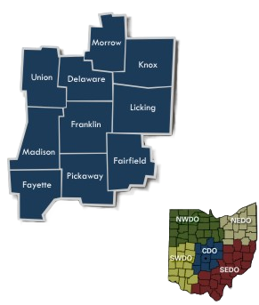
Marshall Cooper | Delaware, Franklin, Fayette, Madison, Morrow, and Pickaway (areas west of I-71) Fairfield, Knox, Licking, and Union | 614-728-3844
Rahel Babb | Delaware, Franklin, Fayette, Madison, Morrow, and Pickaway (areas east of I-71) | 614-728-3855
Central District

Slide 3
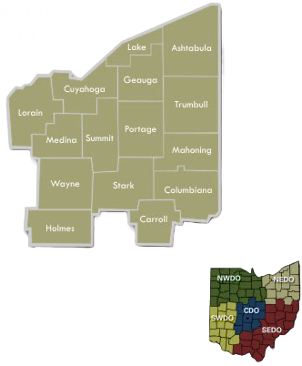
Northeast District
Zorica Dejanovic | Stark, Carroll, Columbiana, Mahoning, and Trumbull | 330-963-1222
Laura Shriver | Cuyahoga, Lake, Lorain, Geauga, and Holmes | 330-963-1136
Ed Wilk | Ashtabula, Medina, Portage, Summit, and Wayne | 330-963-1172

Slide 4
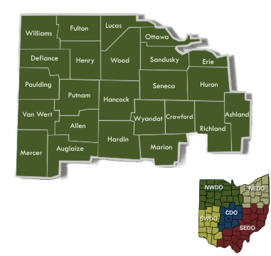
Northwest District
Stefen Pargeon | Ashland, Crawford, Erie, Huron, Lucas, Ottawa, Sandusky, Seneca, Richland | 419-373-3021
Jacqueline Kniss | Allen, Auglaize, Defiance, Hancock, Hardin, Henry, Marion, Mercer, Paulding, Putnam, Van Wert, Williams, Wood | 419-373-3025

Slide 5
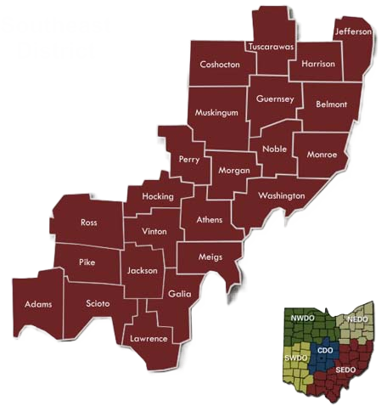
Southeast District
Alex Delvalle | All Counties | 740-380-5227

Slide 6
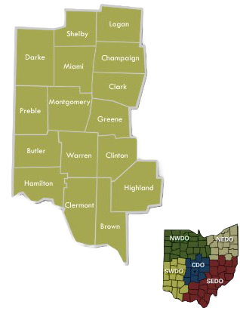
Southwest District
Michelle Flanagan | Clark, Darke, Hamilton, Logan, Miami, Montgomery, Preble, and Shelby | 937-285-6440
VACANT | Brown, Butler, Champaign, Clermont, Clinton, Greene, Highland, and Warren | 937-285-6031

