Slide 1
SWCD/Ohio EPA Working Partnership Guidance Document
February 21, 2023
Molly Conley – Warren SWCD – Director
Jennifer Fish – Franklin SWCD - Director
Justin Reinhart – Ohio EPA – Stormwater Engineer, Division of Surface Water

Slide 2
SWCD Stormwater/Urban Work
Urban Networking Committee History
2010 – First SWCD urban committee started with leadership from Butler SWCD
2016 – Reboot of committee with name change to Urban Networking Committee with leadership from Franklin SWCD
2018 –UNC begins reporting out to OFSWCD as a well-established committee
UNC
Work with OFSWCD leadership to establish SWCDs as the preferred municipal stormwater assistance agency for municipalities, townships and other units of local government by coordinating with Ohio EPA and providing support to SWCDs to develop expertise in stormwater and urban conservation projects.
Public Education and Involvement
Education to Municipal Officials, Engineers, and Developers
Mapping and Inspection of Stormwater Sewer System
Development Plan Review
Construction Site Inspections
Post Construction Inspection and Management
Pollution Prevention

Slide 3
Urban Networking Committee
Comprised of 55 SWCD staff, Ohio EPA, ODA, OFSWCD and Ohio Stormwater Association
Goals:
Maintain and expand a network of support to SWCD offices so that all SWCDs can service local municipalities with urban programming and stormwater permit compliance.
Stay actively engaged and visible with OFSWCD leadership by coordinating and assisting with social media, website, meetings and conferences.
Coordinate an online resource hub for Ohio's 88 SWCDs.
Current Work: 2023 Unveiling of SWCD/Ohio EPA Working Partnership: Guidance Document for SWCD Urban Stormwater and Ohio EPA Staff

Slide 4
SWCD/Ohio EPA Working Partnership
As more and more SWCDs become established stormwater program providers, there is a need for a strong working partnership with the Ohio EPA!
Established in 2022
Committee comprised of members of unc and ohio epa
First order of business was to establish a guidance document to that could inspire a strong working partnership
Focuses on communication between swcd district staff and ohio epa regional staff
Organizing committee will meet yearly
Local staff encouraged to participate in yearly regional meetings
Both agencies committed to continuing education
+

Slide 5
Organizing Committee
Meet on a yearly basis
Discuss guidance document
Relay successes and hurdles from prior year
Expand guidance document as needed

Slide 6
Local effort guidance
Excellent communication is the goal!
Guides SWCDs & Ohio EPA to participate in yearly regional meetings per Ohio EPA District
Suggests communication protocols
Preferred methods of communication
Chain of command protocol
Update Contact Lists
Discuss appropriate response timelines
Details information to be exchanged
Expectations for information requests/complaints received by Ohio EPA and handled by SWCDs
Review MS4 MCMs 1-6: roles, expectations, reduce duplicate effort, process improvements, permit updates, annual reports, compliance support
Pollution complain response, routing, communication
Local regulations
Local MOUs/Contracts/Partnerships

Slide 7
training
SWCDs and Ohio EPA are committed to continuing to provide and to improve staff training!
New staff training – SWCD & Ohio EPA
Urban TDPs through ODA – Ohio EPA assists
Project/specific situation-based training
Regional roundtable support

Slide 8
Ohio EPA Stormwater
Program Manager
Jason Fyffe
614-728-1793
District Stormwater Coordinator(s)
SW Technical Assistance
Statewide SW Coordinator
SW Permitting
Justin Reinhart
614-705-1149
Supervisor
Wesley Sluga
614-644-2141
(NWDO)
Lynette Hablitzel
419-373-3009
What We Do: Complaints, Site Inspections, MS4 Audits
Technical Specialist
VACANT
Michael Joseph
614-752-0782
construction/industrial
What We Do: Construction permit: BMP design, calculations, coverage requirements, SWP3 reviews , technical education, Rainwater Manual
Anthony Robinson
514-728-3392
ms4/industrial
What We Do: What we do: construction, industrial, and municipal coverage submittals, processing, renewals, transfers, and terminations. Industrial sampling and no exposure certification. MS4 annual reports. STREAMS NOI and NOT forms.
Primary Contacts
email address: first.last@epa.ohio.gov

Slide 9
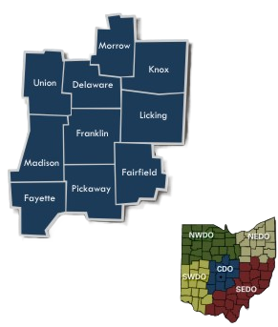
Marshall Cooper | Delaware, Franklin, Fayette, Madison, Morrow, and Pickaway (areas west of I-71) Fairfield, Knox, Licking, and Union | 614-728-3844
Rahel Babb | Delaware, Franklin, Fayette, Madison, Morrow, and Pickaway (areas east of I-71) | 614-728-3855
Central District

Slide 10
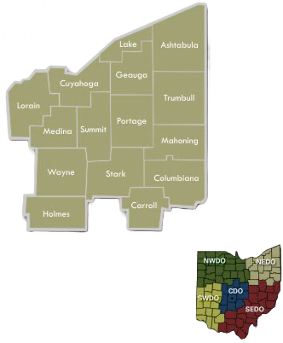
Northeast District
Zorica Dejanovic | Stark, Carroll, Columbiana, Mahoning, and Trumbull | 330-963-1222
Laura Shriver | Cuyahoga, Lake, Lorain, Geauga, and Holmes | 330-963-1136
Ed Wilk | Ashtabula, Medina, Portage, Summit, and Wayne | 330-963-1172

Slide 11
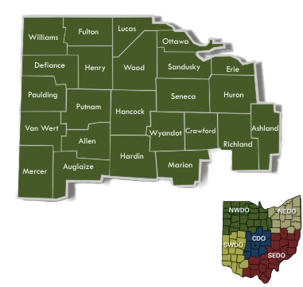
Northwest District
Stefen Pargeon | Ashland, Crawford, Erie, Huron, Lucas, Ottawa, Sandusky, Seneca, Richland | 419-373-3021
Jacqueline Kniss | Allen, Auglaize, Defiance, Hancock, Hardin, Henry, Marion, Mercer, Paulding, Putnam, Van Wert, Williams, Wood | 419-373-3025

Slide 12
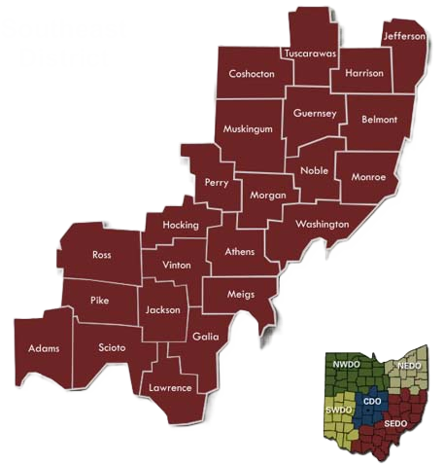
Southeast District
Alex Delvalle | All Counties | 740-380-5227

Slide 13
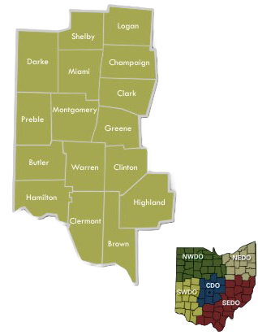
Southwest District
Michelle Flanagan | Clark, Darke, Hamilton, Logan, Miami, Montgomery, Preble, and Shelby | 937-285-6440
VACANT | Brown, Butler, Champaign, Clermont, Clinton, Greene, Highland, and Warren | 937-285-6031

